Slide 1
Slowly Changing Dimension (SCD)
Change Data Capture (CDC)
Muhammad Khalid

Slide 2
Slowly Changing Dimension (SCD): Managing Changing Data in Data Warehousing
Muhammad Khalid

Slide 3
Introduction to Slowly Changing Dimension (SCD)
SCD is a technique used to manage and track changes to dimensional data over time.
In this presentation, we will explore the concept of SCD, its importance, and various strategies for implementation.

Slide 4
Why Manage Changing Data?
Dimensional data in a data warehouse represents descriptive attributes of business entities.
Business entities, such as customers, products, or locations, undergo changes over time.
It is crucial to capture and manage these changes to maintain data integrity and enable historical analysis.

Slide 5
The Need for Slowly Changing Dimension (SCD)
Traditional update strategies may overwrite historical data, resulting in a loss of valuable information.
SCD addresses this challenge by providing strategies to manage changing data while preserving historical context.

Slide 6
SCD Types Overview
SCD provides different types or strategies to handle changing data:
SCD Type 1: Overwrite Strategy
SCD Type 2: Historical Tracking Strategy
SCD Type 3: Add New Attribute Strategy

Slide 7
SCD Type 1: Overwrite Strategy
In SCD Type 1, the existing record is updated with the new values when a change occurs.
Historical information is not preserved, as the old values are permanently replaced.
This strategy is suitable when only the latest data is relevant and historical tracking is not required.

Slide 8
Demo SCD 1

Slide 9
SCD 1
Source Table
Data Warehouse Table
ID | Name | Salary | Designation
001 | John | 2000 | Developer

Slide 10
SCD 1
Source Table
Data Warehouse Table
ID | Name | Salary | Designation
001 | John | 2000 | Developer
ID | Name | Salary | Designation
001 | John | 2000 | Developer

Slide 11
SCD 1
Source Table
Data Warehouse Table
ID | Name | Salary | Designation
001 | John | 3000 | Senior Developer
ID | Name | Salary | Designation
001 | John | 2000 | Developer

Slide 12
SCD 1
Source Table
Data Warehouse Table
ID | Name | Salary | Designation
001 | John | 3000 | Senior Developer
ID | Name | Salary | Designation
001 | John | 3000 | Senior Developer

Slide 13
Benefits of SCD Type 1
Simplicity
Storage Efficiency
Performance
Data Consistency

Slide 14
Limitations of SCD Type 1:
Historical Analysis
Data Auditing
Limited Trend Analysis
Backward Compatibility
Loss of Historical Context

Slide 15
SCD Type 2: Historical Tracking Strategy
SCD Type 2 creates a new record for each change
Preserve the historical context of the data.
New records are assigned a surrogate key
Additional columns to track the start and end dates of each version.

Slide 16
Demo SCD 2

Slide 17
SCD 2
Source Table
Ware House Table
ID | Name | Salary | Office | Start Date
001 | John | 2000 | London | 27/06/2020

Slide 18
SCD 2
Source Table
Ware House Table
ID | Name | Salary | Office | Start Date
001 | John | 2000 | London | 27/06/2020
ID | Name | Salary | Office | Start Date | End Date
001 | John | 2000 | London | 27/06/2020 | 31/12/2099

Slide 19
SCD 2
Source Table
Ware House Table
ID | Name | Salary | Office | Start Date
001 | John | 2000 | Leeds | 12/10/2022
ID | Name | Salary | Office | Start Date | End Date
001 | John | 2000 | London | 27/06/2020 | 31/12/2099

Slide 20
SCD 2
Source Table
Ware House Table
ID | Name | Salary | Office | Start Date
001 | John | 2000 | Leeds | 12/10/2022
ID | Name | Salary | Office | Start Date | End Date
001 | John | 2000 | London | 27/06/2020 | 11/10/2022
001 | John | 2000 | Leeds | 12/10/2022 | 31/12/2099

Slide 21
SCD 2
Source Table
Ware House Table
ID | Name | Salary | Office | Start Date
001 | John | 2000 | Shefield | 20/03/2023
ID | Name | Salary | Office | Start Date | End Date
001 | John | 2000 | London | 27/06/2020 | 11/10/2022
001 | John | 2000 | Leeds | 12/10/2022 | 31/12/2099

Slide 22
SCD 2
Source Table
Ware House Table
ID | Name | Salary | Office | Start Date
001 | John | 2000 | Shefield | 20/03/2023
ID | Name | Salary | Office | Start Date | End Date
001 | John | 2000 | London | 27/06/2020 | 11/10/2022
001 | John | 2000 | Leeds | 12/10/2022 | 19/03/2023
001 | John | 2000 | Shefield | 20/03/2023 | 31/12/2099

Slide 23
Benefits of SCD Type 2
Historical Analysis
Data Consistency
Auditing and Compliance
Flexibility in Rollback

Slide 24
Limitations of SCD Type 2
Increased Storage Requirements
Complex Queries
Data Management Overhead
Slower Updates and Inserts
Increased Table Complexity

Slide 25
SCD Type 3: Add New Attribute Strategy
SCD Type 3 adds new attribute columns to the existing record to track limited historical changes.
A new column captures the previous value of the changing attribute.
This strategy allows for some historical tracking while minimizing the growth of the dimension table.

Slide 26
Demo SCD 3

Slide 27
SCD 3
Source Table
Ware House Table
ID | Name | Salary | Office | Start Date
001 | John | 2000 | London | 27/06/2020

Slide 28
SCD 3
Source Table
Ware House Table
ID | Name | Salary | Office | Start Date
001 | John | 2000 | London | 27/06/2020
ID | Name | Salary | Prev_Office | Curr_Office | Start Date
001 | John | 2000 | Null | London | 27/06/2020

Slide 29
SCD 3
Source Table
Ware House Table
ID | Name | Salary | Office | Start Date
001 | John | 2000 | Leeds | 20/09/2022
ID | Name | Salary | Prev_Office | Curr_Office | Start Date
001 | John | 2000 | Null | London | 27/06/2020

Slide 30
SCD 3
Source Table
Ware House Table
ID | Name | Salary | Office | Start Date
001 | John | 2000 | Leeds | 20/09/2022
ID | Name | Salary | Prev_Office | Curr_Office | Start Date
001 | John | 2000 | London | Leeds | 20/09/2022

Slide 31
SCD 3
Source Table
Ware House Table
ID | Name | Salary | Office | Start Date
001 | John | 2000 | Sheffield | 15/04/2023
ID | Name | Salary | Prev_Office | Curr_Office | Start Date
001 | John | 2000 | London | Leeds | 20/09/2022

Slide 32
SCD 3
Source Table
Ware House Table
ID | Name | Salary | Office | Start Date
001 | John | 2000 | Sheffield | 15/04/2023
ID | Name | Salary | Prev_Office | Curr_Office | Start Date
001 | John | 2000 | Leeds | Sheffield | 15/04/2023

Slide 33
Benefits of SCD Type 3
Limited Storage Impact
Simplicity
Query Performance
Balanced Historical Context

Slide 34
Limitations of SCD Type 3
Limited Historical Analysis
Limited Backward Compatibility
Data Integrity Challenges
Scalability Issues
Increased Data Duplication

Slide 35
Change Data Capture (CDC)
Muhammad Khalid

Slide 36
Introduction
Definition of CDC
Purpose and Benefits
How CDC works

Slide 37

Applications
Reporting
source
ETL
Data
Warehouse

Slide 38
Limitations
Batch processing
Update and delete capture
Load on source database

Slide 39
Change Data Capture
Applications
Reporting
source
ETL
Data
Warehouse
change

Slide 40
Why CDC Matters
Real-time Data Integration
Data Synchronization
Auditing and Compliance

Slide 41
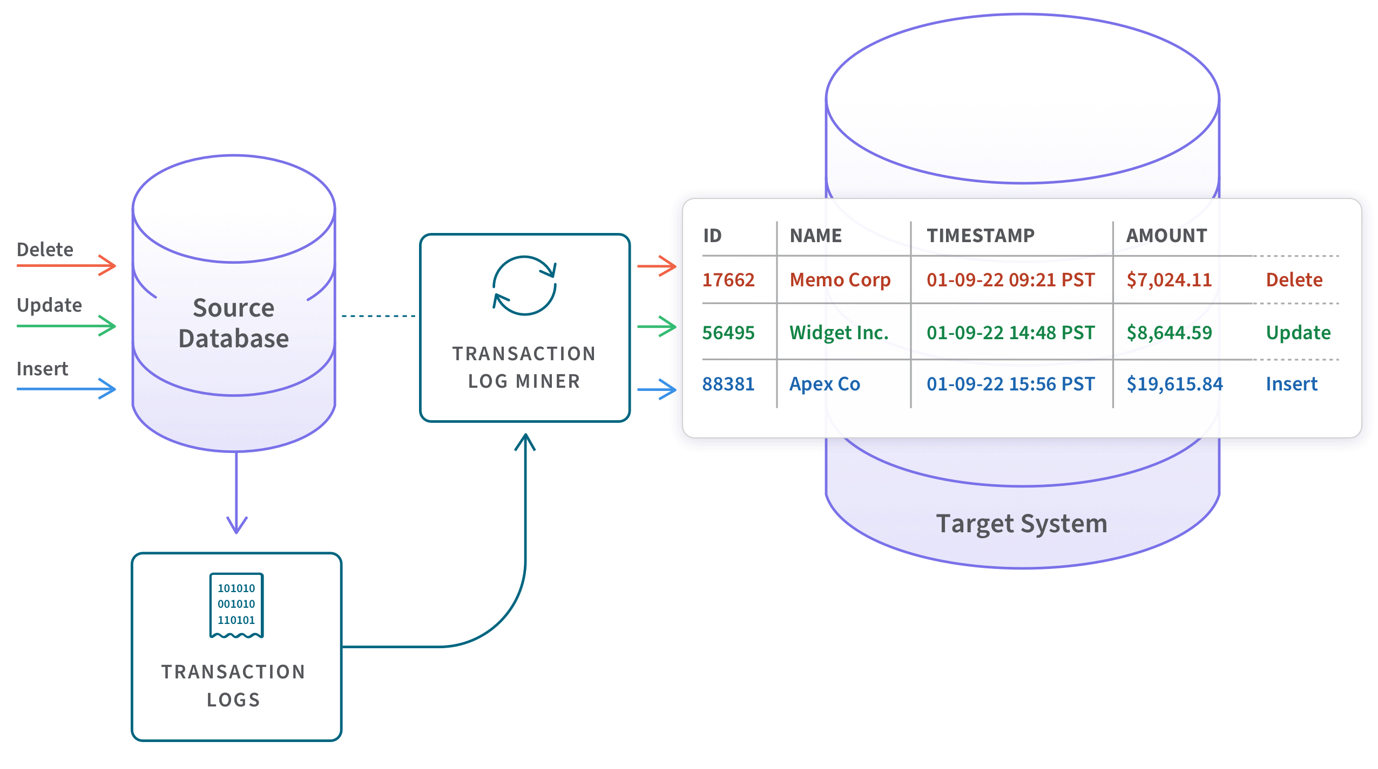
CDC Methods
1 Log-based CDC.

Slide 42
CDC Methods
Query-based CDC.
Trigger-based CDC

Slide 43
CDC Implementation
Capturing Data Changes
01
Storing and Managing Change Data
02

Slide 44
Demo
CDC in SQL Server

Slide 45
Use Cases of CDC
Real-time Analytics
Data Warehousing
Auditing and Compliance

Slide 46
Q&A

